Slide 1
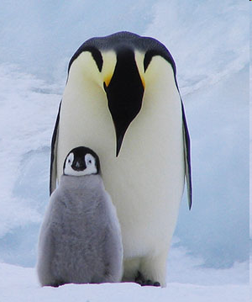
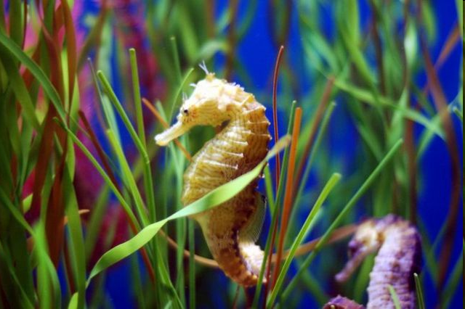
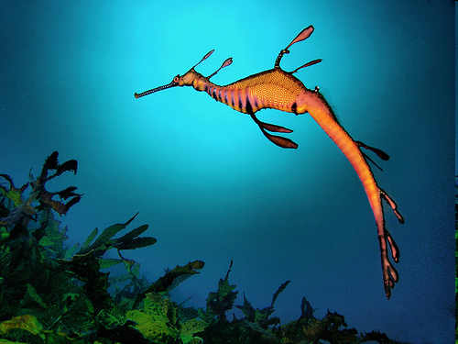
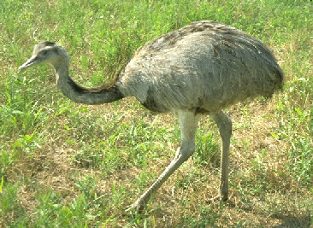
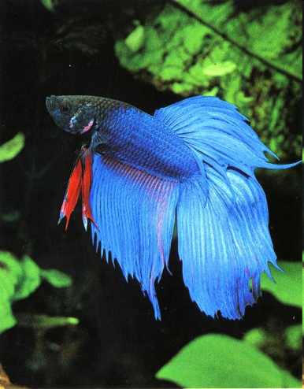
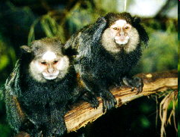
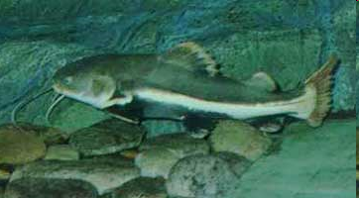
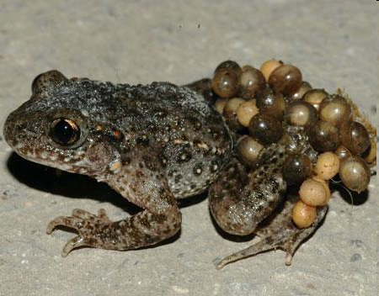
?

Slide 2
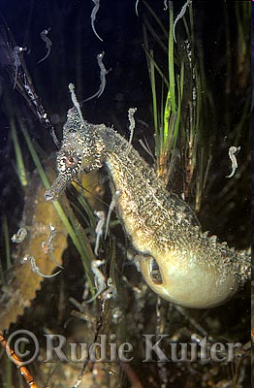
The Seahorse
During courtship, the female sea horse transfers her eggs to the father's pouch, located under his tail. The father can carry as many as 200 eggs.
After a month or so, the eggs will hatch. When the babies are ready to be born, the father finds a sturdy reed and attaches himself to it with his tail. Then he begins to squeeze the muscles in his pouch, releasing a baby with each contraction.

Slide 3
Marmosets
Marmosets are tiny South American monkeys. The fathers take care of their babies from birth. When the marmoset is born, the father cleans it, then carries it to the mother only when it needs to be nursed. When the baby can eat solid food, the father will feed it.

Slide 4
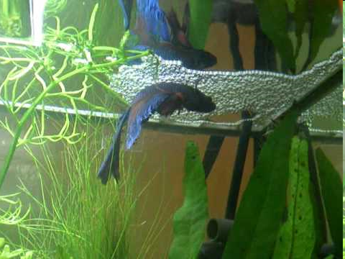
Siamese Fighting Fish
When the mother lays her eggs, the father catches them in his mouth, then drops them into a bubble nest he has prepared at the surface by blowing bubbles to which the eggs stick. He guards the nest and protects the baby fish when they hatch.

Slide 5
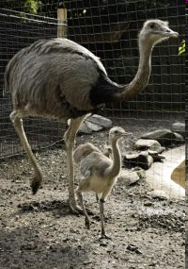
Rheas
Rheas are large South American birds similar to ostriches.
Father rhea takes sole care of his young. From eggs to
chicks, he feeds, defends, and protects them until they are
old enough to survive on their own.

Slide 6
The Midwife Toad
When the female midwife toad lays her eggs, they are tied together like two strings of pearls. The father carries these strings on his legs for three to four weeks. He sleeps during the day and hunts for insects at night. He makes sure that the eggs are kept moist by hopping through puddles and wet grass. When it is time, the father midwife goes to the pond and waits for his tadpoles to hatch and swim away.

Slide 7
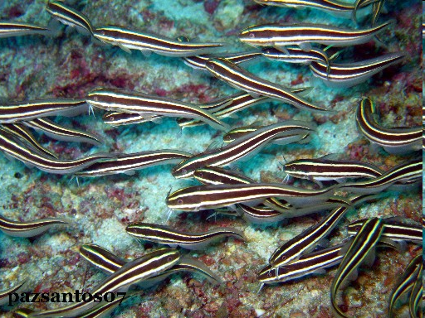
The Sea Catfish
The father sea catfish uses his
mouth as a nursery! As soon as
the mother lays her eggs, the
father takes them into his
mouth to care for them. Even
after the eggs hatch, the babies
remain in their father's mouth
and continue to grow. During
this time, he keeps his mouth
closed and does not eat. When
the babies are about two
inches long, the father opens
his mouth and the tiny fish swim
away.

Slide 8
The Emperor Penguin
In the coldest part of winter, when the temperature in Antarctica can reach forty degrees below zero, the female emperor penguin lays a single egg. Then she goes off to sea to feed and build her strength.
The father penguin rolls the egg onto the top of his feet and covers it with his belly. Then he stands with hundreds of other father penguins for eight weeks, keeping his egg warm. Unable to hunt or to eat, the father penguin loses forty percent of his body weight before the egg hatches.
The female returns just before the egg hatches. Now the father goes off to sea to feed and recover his strength. When he returns, both the father and the mother care for the chick.

Slide 9
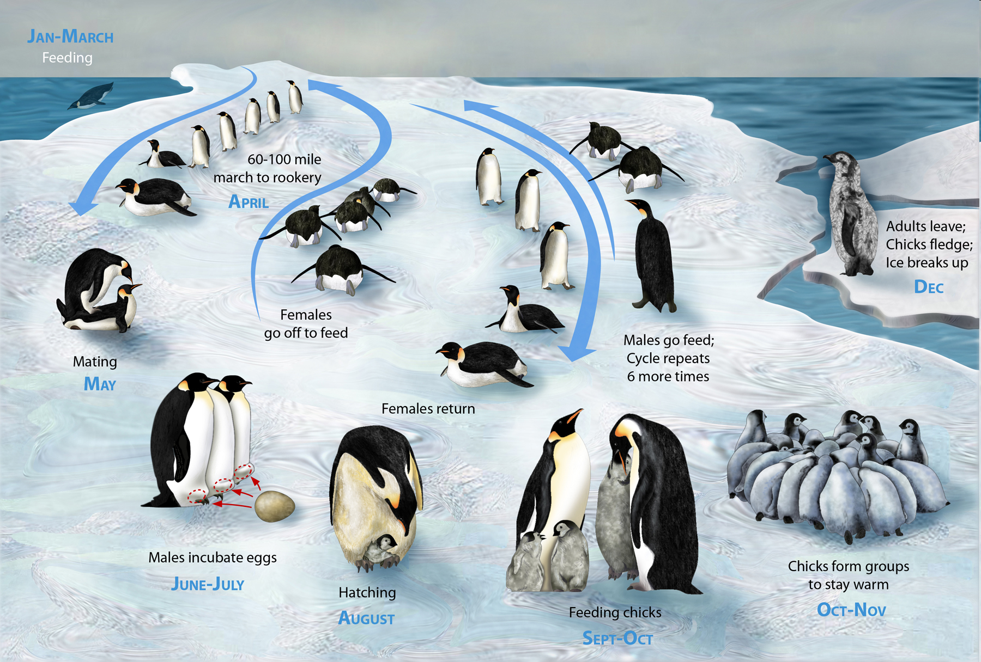
The Emporer Penguin

Slide 10
The Human Father

